Slide 1
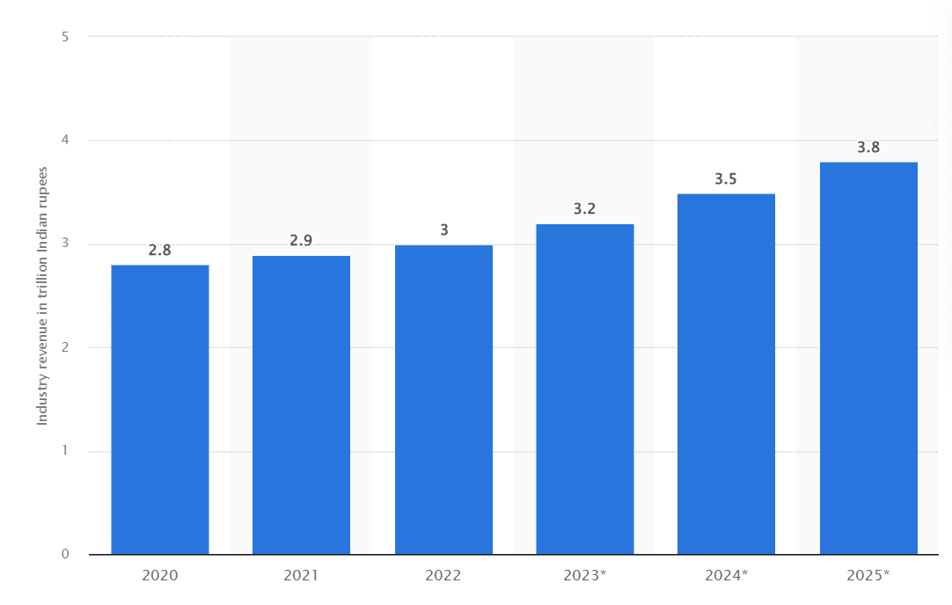
An eagle-eye view in India Telecom Industry
GROWTH DRIVERS
Telecom Sector Reforms
In 2021, large scale structural and procedural reforms have been brought in to enhance liquidity and minimise financial stress within the telecom sector.
Bharatnet project
Under the BharatNet Project 1,77,550 Gram Panchayats (GPs) have been made service ready.
India is one of the highest consumers of data per day (~5 hours of daily time spend on smartphones by consumers).
Prime Minister Wi-Fi Access Network Interface (PM-WANI)
Provision of public Wi-Fi service through Public Data Offices (PDOs) spread across the country to accelerate the expansion of broadband internet services
PLI Schemes under Atmanirbhar Bharat Abhiyan
Production Linked Incentive (PLI) Scheme worth INR 12.2k Cr for manufacturing of telecom and networking products. Incentives worth more than INR 4k Cr have been earmarked for the Design Led Manufacturing Scheme of the existing PLI Scheme.
India is soon to become the second-largest smartphone market globally by 2025 with around 1 Bn installed devices and is expected to have 920 Mn unique mobile subscribers by 2025 which will include 88 Mn 5G connections. 5G technology to contribute ~$450 Bn (estimated) to the Indian Economy in the period of 2025-2040.
Not Peer Reviewed
Digital India initiative
5G blocks ► Bharat 6G Vision
Digital payments
National Broadband Mission (NBM)
Affordable ► Sustainable ► Ubiquitous
Revenue of telecommunications services industry in India from 2020 to 2022 with forecasts until 2025
(in trillion Indian rupees)
Source: Statista

